Slide 1
Overview of Today’s Class
Homework 1 solution
SOLID/Single Responsibility Principle
Java packages
Scope
Encapsulation
Types and subtyping
Static factory classes
Strategy Pattern
Command Pattern
Homework 2

Slide 2
Homework 1 solution - VideoObj
VideoObj.toString method: Did you use a StringBuilder?
Is VideoObj immutable?

Slide 3
Homework 1 solution - VideoTEST
In VideoTEST.testConstructorExceptionDirector, did you test for null, empty string, AND whitespace?
Does VideoTEST.testEquals test against null (to make sure no null pointer exception is thrown), new Object (to make sure no cast exception is thrown), and passing in copies of director and title strings to make sure it’s comparing the values and not the pointers?
Does VideoTEST.testCompareTo test comparison between the same two objects? What about two different objects with the same values in their fields? Does a.compareTo(b) equal the opposite of b.compareTo(a)?

Slide 4
Homework 1 solution - InventorySet
Does toCollection return the objects or a COPY of the objects?
Are the conditions in the comments used in your unit tests?
Does checkout increment numOut and numRentals on Record?
Do addNumOwned, checkOut, and checkIn have guard clauses?

Slide 5
Homework 1 solution - InventoryTEST
Does your test for testToCollection verify it’s returning a copy of the objects and not the objects themselves?
Does testGet verify the same?

Slide 6
How to unit test
Check for edge cases
Null, empty lists, index out of range, etc.
Use requirements to easily add test conditions
Make sure to test for when exceptions should be thrown
Make sure other unit tests do not affect the outcome of this unit test!

Slide 7
Introduction to Uncle Bob’s SOLID principles
Uncle Bob - Robert C. Martin
Author of Clean Code and co-author of the Agile Manifesto
SOLID principles:
Single Responsibility Principle
Open-Close Principle
Liskov Substitution Principle
Interface Segregation Principle
Dependency Inversion Principle

Slide 8
Single Responsibility Principle
A class should have only one reason to change
Every time you need to open up a file, you risk breaking something
Allowing access to more (fields/methods) than is necessary is also risky
More responsibilities -> More dependencies
Dependencies change -> rebuilds/retests/redeploys must occur
More dependencies -> more complexity -> more opportunity to break

Slide 9
Single responsibility principle and Homework 1
Did you notice any violations of the SRP in Homework 1?
Notes:
In InventorySet, several methods directly access fields on Record.
There is a lot of logic in the guard clauses – these should be in Record or in a RecordValidator class.
CheckOut/CheckIn have the same logic duplicated.
InventorySet should act solely as a data store.

Slide 10
Single responsibility principle and Homework 1
What if we want to stop keeping track of the total number of rentals?
Notes:
How many classes need to be changed to make this change? How many classes should need to be changed?

Slide 11
Single responsibility principle and Homework 1
Better way of doing this (e.g. checkOut): Two steps:
1. Call “get” on InventorySet – get returns the Record or throws NotFoundException
2. Call “checkOut” on record. Record performs validation on the request and “checks out” the movie.
Notes:
InventorySet should act solely as a data store.

Slide 12
Java packages
C++/C#: Namespaces
Packages: Group related classes
e.g. package myhw1;
Packages path matches source path
e.g. package types.simplePackage.Main -> types\simplePackage\Main.java

Slide 13
Java packages
Using a class from another package (fully qualified name):
new java.util.LinkedList();

Slide 14
Java packages
Or you can import classes and use them without the fully qualified name:
import java.util.LinkedList;
…
new LinkedList();

Slide 15
Java packages
If you have many classes from another package you want to use, you can import the entire package:
import java.util.*;
…
new LinkedList();
new Random();
Import statement helps resolve names.

Slide 16
Classpath
The classpath tells Java from where to load classes from user-created packages
If no classpath specified, Java looks in current folder
In other words, it can only load files from the default package
The classpath can contain multiple folders

Slide 17
Classpath demo
javac src1\package1\Main.java
javac src2\package2\Movie.java
javac -classpath src2 src1\package1\Main.java
java package1.Main
java -classpath src1 package1.Main
java -classpath src1;src2 package1.Main
Notes:
Draw folder hierarchy on board!

Slide 18
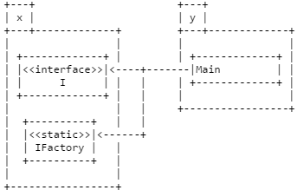
Package diagrams
A top-level package diagram typically shows all of the packages in a system. Sometimes it also includes the public classes/interfaces within each package (usually by name only--no fields or methods listed). You can then show the dependencies between these public portions of the packages.

Slide 19
Package diagrams
Note that the diagram does not show "intra-package" dependencies, only "inter-package" dependencies; that is, we do not show dependencies within a package, but only between packages

Slide 20

Package diagrams
More abstract version

Slide 21
Scope
Scope determines the visibility of fields, methods, and classes
Scope can be determined in two ways: keywords (e.g. public, private) and code blocks (e.g. {})
Members of outer scopes are visible to members of inner scopes, but not the other way around

Slide 22
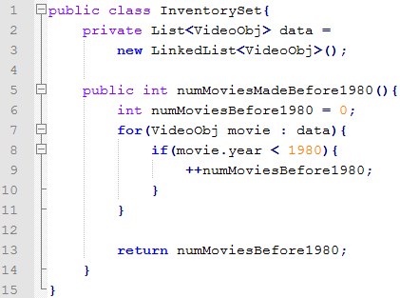
Scope
class InventorySet: public (global) scope
List<VideoObj> data: private (internal) scope, visible only to objects of this class
int numMoviesBefore1980: visible only to the numMoviesMadeBefore1980 method
VideoObj movie: visible only to the for loop

Slide 23
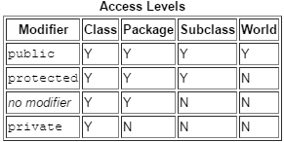
Visibility
Four types of visibility in Java:
Private
Protected
Package-private (C# has internal)
Public

Slide 24
Encapsulation
Keep implementation details hidden
“Black box programming”
Large organizations function because not everyone needs to know every detail all the time -- they break down when too many people need to know too much.

Slide 25
Encapsulation
Math.random() provides a pseudo-random number without the caller needing to know how
Encapsulating is about abstracting the functionality from the caller
In Java, when you send information across a network, you don’t create individual packets

Slide 26
Abstraction
OO Design is about defining good abstractions
Abstractions distribute responsibilities
Code provider vs code consumer/client

Slide 27
Interfaces
An interface (the concept, not the Java construct interface) is what client programmers interact with:
The interface of a package is the names of its public classes and interfaces.
The interface of a class (or interface) is the name and type of its public members.
The interface of a method is its type (arguments and return).

Slide 28
Designing interfaces
What makes a good method?
What makes a good class?
What makes a good package?

Slide 29
Designing interfaces
Good interfaces have high cohesion
Cohesion - should be describable in one short sentence
Cohesion = SRP

Slide 30
Encapsulation: principle of least knowledge
Hide as much as possible
Don’t make commitments you can’t keep
The more you hide, the less chance you have for tight coupling
Think back to SRP issue in Homework 1 – Record and InventorySet are “tightly” coupled. Changes to Record can require changes to InventorySet
Only acceptable time where changing the functionality of one class changes others is when a public interface is changed

Slide 31
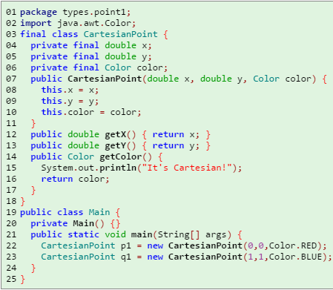
Types
What is the Type of p1?
What is the Type of q1?

Slide 32
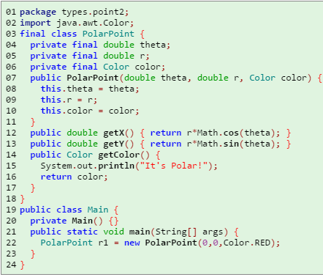
Types
What is the Type of r1?

Slide 33
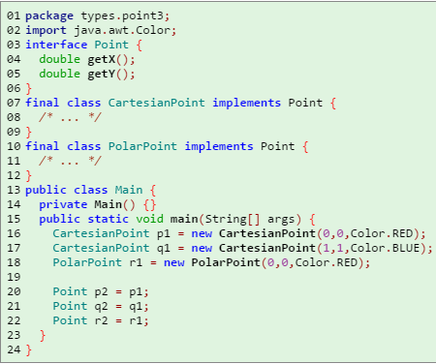
Types
What are the Types of p2, q2, and r2?

Slide 34
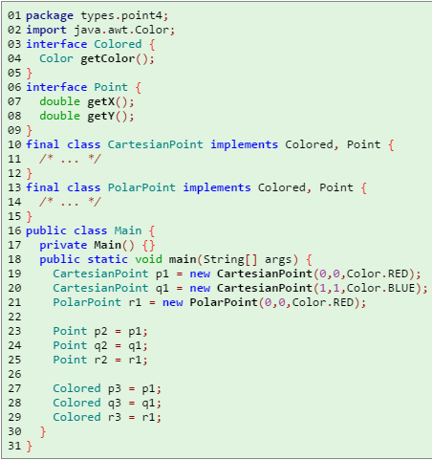
Types
What are the types of p3, q3, and r3?

Slide 35
Declared and actual types
Declared type = Static type = Compile-time type = type of the reference
Actual type = Dynamic type = Run-time type = type of the object
Typically refer to type of variable

Slide 36
Subtypes
A subtype is a type that extends another type
Even though it’s “extending”, a subtype could have less functionality than the parent (private methods)
Objects can be subtypes of more than one type (e.g. Integer is a subtype of both Object and Comparable)
Subtyping is Transitive (if A : B and B : C, then A : C)

Slide 37

Subtypes: specificity
When assigning an object to a reference, the left side will always be less specific or as specific as the right side
Valid:
Valid:
Invalid:

Slide 38
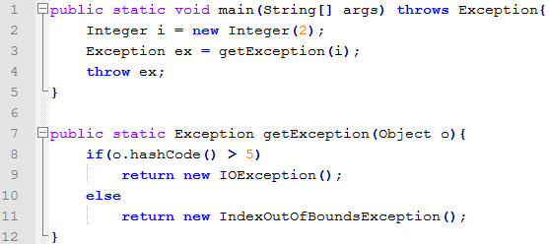
Subtypes: specificity
When calling a method, you can pass in the requested type as an argument or a more specific type (contravariance). The return type will be as specific or less specific than the type of the objects being returned (covariance)

Slide 39
Multiple class inheritance
Java* and C# don’t offer Multiple Inheritance. Why?

Slide 40
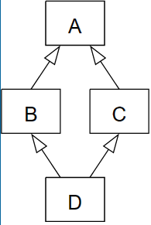
Multiple class inheritance
“The Diamond Problem”
Lower level classes inherit fields (state) from parent objects.

Slide 41

Interfaces
Interfaces provide no implementation*, they only provide a contract to consumers guaranteeing an implementing object has certain methods (and/or properties in C#), and what those method signatures look like

Slide 42
Multiple inheritance from interfaces
Java and C# allow classes to implement multiple interfaces
The Diamond Problem doesn’t exist with interfaces – why?

Slide 43
Java 1.8: default interface implementation
Java 1.8 introduced a new feature that allows you to create a “default interface implementation”
Notes:
//Uncommenting h or g below causes interface K to fail to compile
interface I1 {
public void f ();
default public void g () { System.out.println ("I1.g"); }
//public void h ();
}
interface I2 {
public void f ();
//default public void g () { System.out.println ("I2.g"); }
default public void h () { System.out.println ("I2.h"); }
}
interface K extends I1, I2 { }
class C implements K {
public void f () { System.out.println ("C.f"); }
}
public class Main {
public static void main (String[] args) {
C x = new C ();
x.f ();
x.g ();
x.h ();
}
}

Slide 44
Java 1.8: default interface implementation
If a class implements multiple interfaces, and multiple have a default implementation for the same method, the implementing class must specify its own implementation
Notes:
interface I0 {
public void f ();
}
interface I1 extends I0 {
default public void g () { System.out.println ("I1.g"); }
}
interface I2 extends I0 {
default public void g () { System.out.println ("I2.g"); }
}
/* It is possible to inherit conflicting defaults, as long as you don't use them!
* If you comment out the definition of g in C or K below, you will get an error!
*/
class C implements I1, I2 {
public void f () { System.out.println ("C.f"); }
public void g () { System.out.println ("C.g"); }
}
interface K extends I1, I2 {
default public void g () { System.out.println ("I2.g"); }
}
public class Main {
public static void main (String[] args) {
C x = new C ();
x.g ();
}
}

Slide 45
Late binding
The actual method being called is determined at Runtime, based on the object’s actual type (not the type of the reference)
(example)
Notes:
interface Colored {
Color getColor();
}
interface Point {
double getX();
double getY();
}
final class CartesianPoint implements Colored, Point {
/* ... */
}
final class PolarPoint implements Colored, Point {
/* ... */
}
public class Main {
public static void main(String[] args) {
CartesianPoint p1 = new CartesianPoint(0,0,Color.RED);
PolarPoint r1 = new PolarPoint(0,0,Color.RED);
printColor(p1);
printColor(p2);
}
public void printColor(CartesianPoint point){
System.out.println(point.getColor());
}
public void printColor(PolarPoint point){
System.out.println(point.getColor());
}
}

Slide 46
Casting
Casting: changing the declared type of an object (does not change the actual object in memory itself)
Downcasting: casting from supertype to subtype
Upcasting: casting from subtype to supertype

Slide 47
Casting – compile-time and run-time checks
In Java, the compiler will check to see if a given cast is potentially valid
It will check if the type you’re trying to cast to is a supertype or subtype of the type you’re trying to cast from
Run-time will also perform the same check – why?
Notes:
public class Main {
public static void main (String[] args) {
String str = "Hello World";
int i = (int)str;
System.out.println(i);
}
}

Slide 48
Type coercion
Coercion: similar in concept (and syntax) to Casting
Changes the actual type of the object, as opposed to casting which changes just the pointer’s declared type and not the object’s actual type
Notes:
public class Main {
public static void main (String[] args) {
float f = 2.5f;
int i = (int)f;
f = i;
System.out.println(f);
}
}

Slide 49
Design patterns
Elements of software design that are reusable
Provide a common vocabulary for software designers
Way of laying out your code/classes that make it easier to maintain/use
Patterns because there is no single use of that design – it’s an abstraction
Not language specific

Slide 50
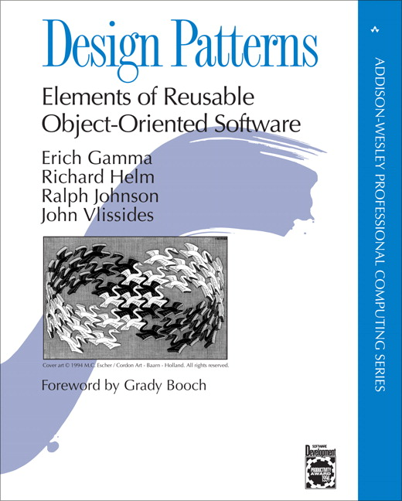
Gang of four
Design patterns first realized by the “Gang of Four”
Their book: Design Patterns: Elements of Reusable Object-Oriented Software

Slide 51
Gang of four design principles
Program to an interface, not an implementation
Favor object composition (delegation) over class inheritance
Consider what should be variable in your design: encapsulate the concepts that vary

Slide 52
Factory
Factory is an object that makes other objects

Slide 53
Static factory classes
What if I want to hide class names from clients?
This could be because class names are still changing or even just because clients don’t need to know (principle of least knowledge)
Use a static factory

Slide 54
Static factory
Make interface public
Make classes package-private
Provide a public static* class (the factory) which will do the actual creation of the objects

Slide 55
Using the static factory
Other packages use the static factory methods, not the constructors of the objects
Factory methods can take in parameters to pass along to the object’s constructors or to initialize the object

Slide 56
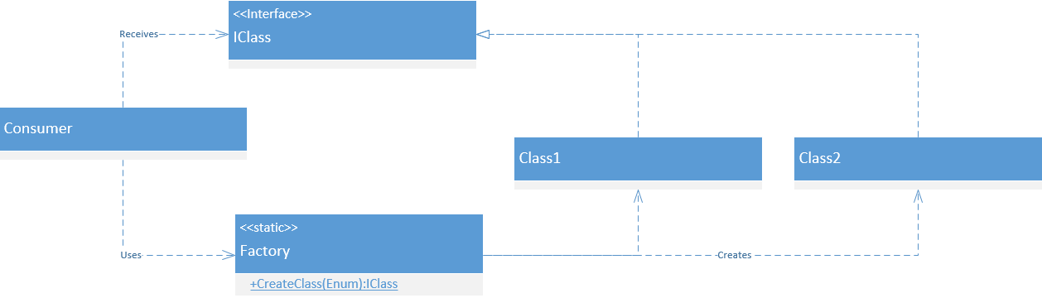
Factory UML

Slide 57
Strategy pattern
We can do part of an algorithm, but not all of it
E.g. Sort(T[], Comparator)
Strategy object provides a consumer with information about what it needs to do
Producer also wants to choose what to run and when
Encapsulates behavior

Slide 58
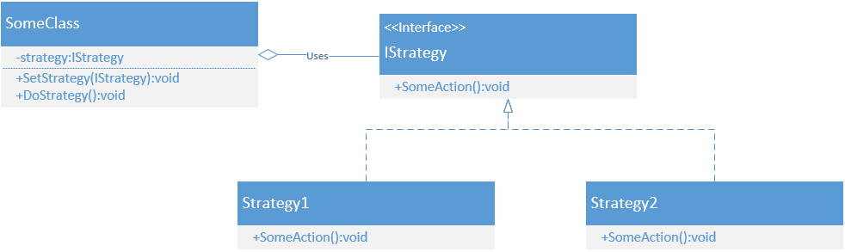
Strategy UML

Slide 59
Command pattern
Very similar to Strategy pattern, but the producer doesn’t care what it does
E.g. Runnable

Slide 60
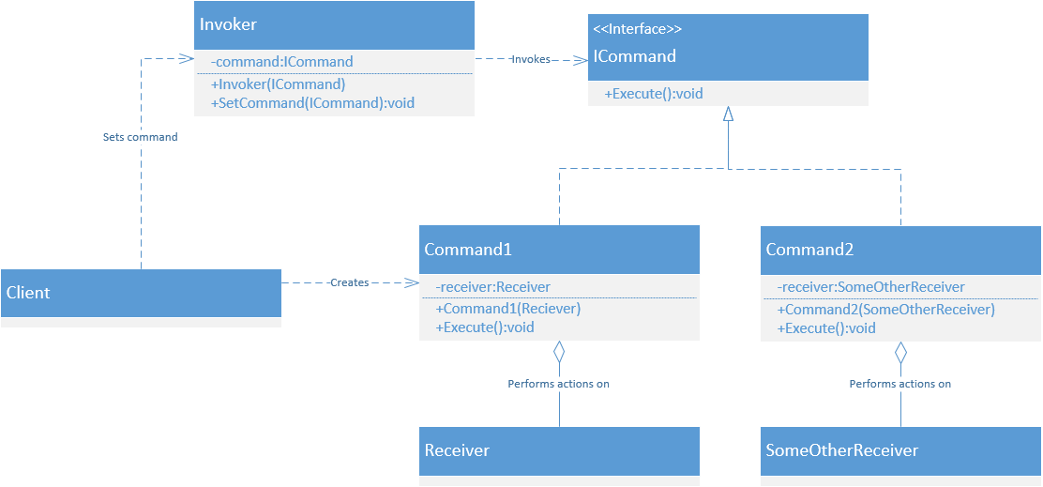
Command UML

Slide 61
Homework 2
Files:
Main.TEST1 (Integration test)
Data.CmdAdd (Command implementation)
Data.CmdOut (Command implementation)
Data.Data (Factory)
InventorySet
InventoryTEST
VideoObj
VideoTEST

Slide 62
Homework 2
Three packages:
myhw2.data
myhw2.command
myhw2.main
There are interfaces for Video, Inventory, and Record
The inventory object classes are all package-private
The static factory Data provides access to inventory objects

Slide 63
Homework 2
The inventory interface has changed substantially
toCollection has been replaced with two Iterator methods: one is an unsorted iterator, the other uses the strategy pattern to return a sorted iterator
The mutator methods of the inventory are all package-private
To modify the inventory from outside the package, one must invoke the run method, passing in a Command object. See the example in Main.TEST1

Slide 64
Homework 2
RecordObj is a nested class, emphasizing its dependence on InventorySet
Since record objects are protected behind the public interface Record, it is no longer necessary to copy them -- they canot be modified outside the myhw2.data package

Slide 65
Homework 2 instructions
Complete the incomplete classes (you may wish to paste in some of your hw-01 solution).
Modify your unit tests so that they pass. (There is no longer any need to test Record)
Write the integration test myhw2.main.TEST1

Slide 66
Homework 2 more information
http://fpl.cs.depaul.edu/jriely/450/lectures/hw-02-002.html
Info on:
Integration tests
Iterator implementation
Testing iterators
Using commands

